Slide 1
How do I get the job I want?
Presented by: Franziska Schropp

Slide 2
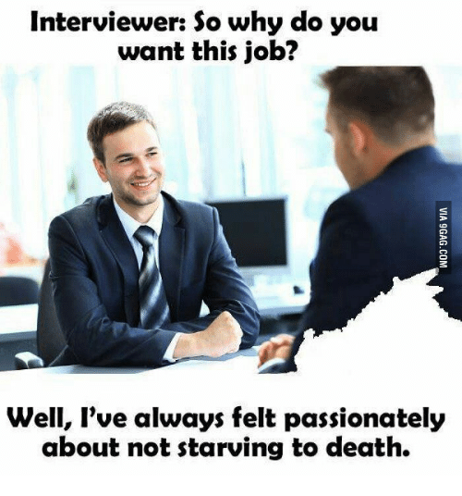

Slide 3
Hello!
I am Franziska/Franzi/Fanny
Python beginner, Speaking beginner
You can find me at:
franziska.schropp@trustyou.com
@franzmaens
Notes:
HR Manager at TrustYou, Tech Recruiter, 3.5 years experience in interviewing, also interview trainer

Slide 5
Application Process Structure
Initial Application
HR Screening
Tech Screening
On Site visit
Notes:
A tech test somewhere inbetween

Slide 6
1.
The Application
Ugh, an application form!

Slide 7
My LinkedIn profile should be enough, right?

Slide 8
My LinkedIn profile might not be enough
If it’s a “one click apply” on LinkedIn, think of ways to distinguish yourself
CV is generally a must
Keep it short but informative (adaptable)
Pay attention to the visuals
Have it proofread
List side projects
State your motivation, but don’t over do it
Show, that you informed yourself about the company

Slide 11
2.
The HR Screening
Sometimes we do know technical things

Slide 12
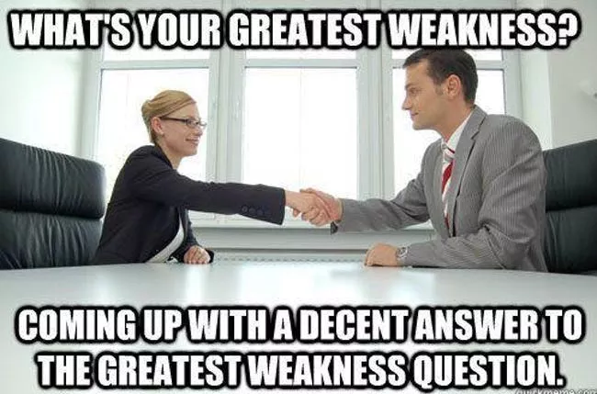

Slide 13
What is this HR interview actually for?
Matching expectations
Motivation
Cultural Fit
Relevant Experience
Salary expectation and availability

Slide 14
Don’ts
Assuming we have no technical knowledge
“I don’t think there is anything you could answer me”
“I’m not sure if you know this…”
Talking non stop vs. one word answers
Constantly interrupting your counterpart
Talking badly about your previous employer
Show, that relocation is your only motivation
Being obviously dishonest (“I have never been criticised”)

Slide 15
Do’s
Be honest: We want a mutual match
Know what you want
Show interest and motivation for the company you are applying to
Ask questions at the end
Prepare beforehand
Leaves a good impression
Eliminate “no Go’s” for you (cultural fit)
Prepare an informed salary expectation
Don’t be afraid to follow up

Slide 16
3.
The Tech Screening

Slide 17
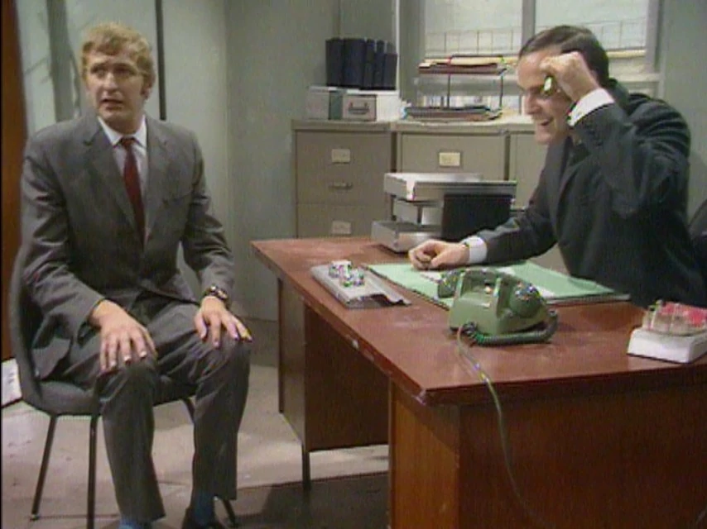

Slide 18
Do’s
Try to find out information beforehand regarding the tech stack the company is using
Mention contributions to side or open source projects
Best practice: Provide links to Github reps or blog posts
Prepare some examples of effective collaboration with your teammates
Staying up to date is important: make sure you can share your sources of information (books, blogs, podcasts, conferences, courses, etc.)

Slide 19
4.
The On Site Visit
You will have to talk to people

Slide 20
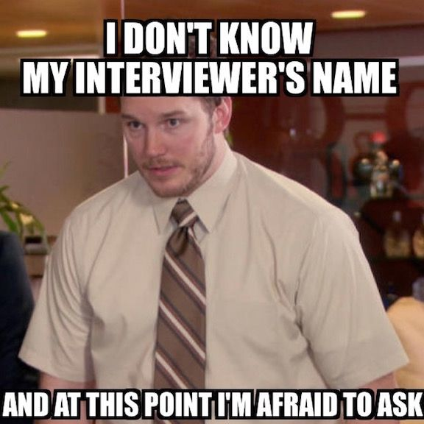

Slide 21
Do’s
Be punctual
In case you are late, inform
Please don’t show up super early
Ask, what to bring in case it’s not in the instruction
Interact with the team
Mind the company’s dress code
React appropriately to feedback or critical questions

Slide 22
Sum up all the things!
Again, motivation! Companies often hire potential over perfect technical fit
Prepare and take it seriously
Don’t tip the scale (confidence vs. arrogance)
Have realistic expectations (e.g. seniority)
Make sure, you are aware of what you want and what you don’t want and communicate it (adequately)

Slide 23
Thanks!
Any questions?
You can find me at:
franziska.schropp@trustyou.com
@franzmaens

