Slide 1
Recipe for TEXT ANALYSIS IN SOCIAL MEDIA:
A LINGUISTIC APPROACH
Eulàlia Veny

Slide 2
Text analysis
Texts in social media
Pre-processing
Strategies and problems
Text modelling
Defining the purpose
Results
Summary
Unsupervised vs. supervised classifier
Gathering the corpus
Real-world applications

Slide 3
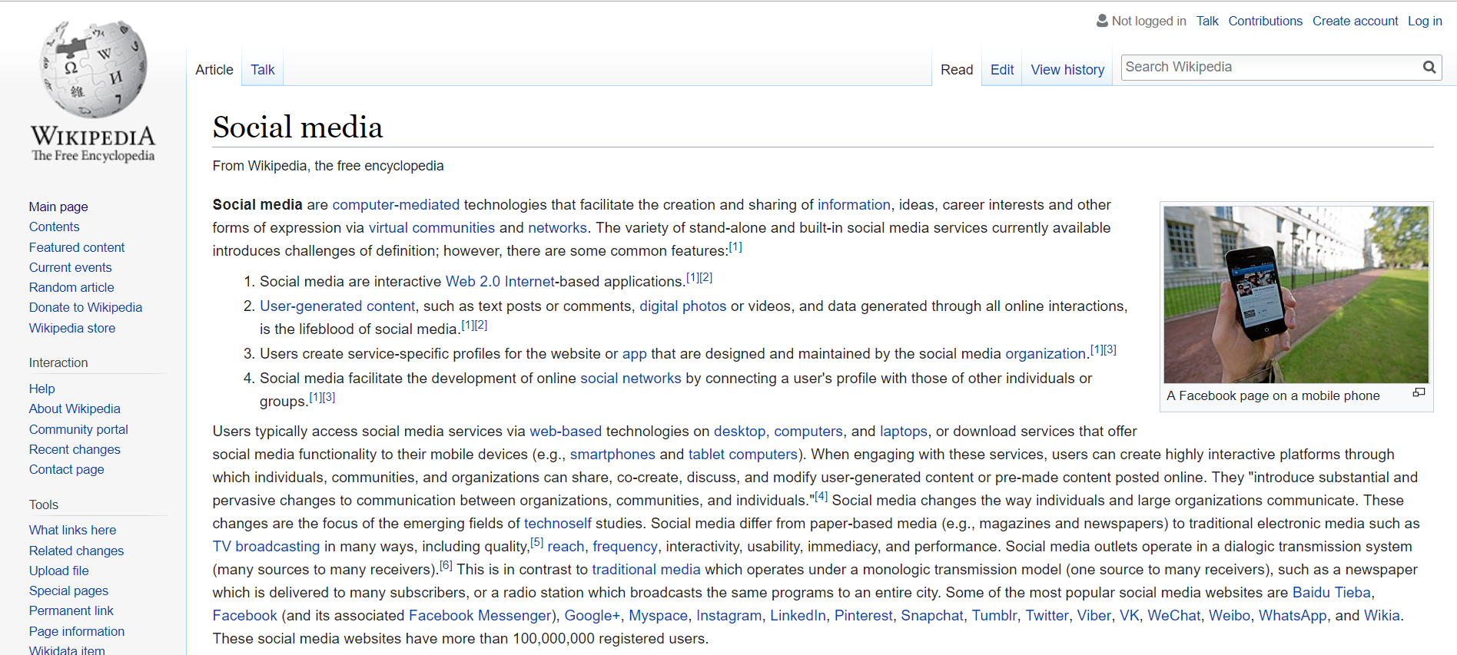
What is social media?
Web-based apps
User-generated content
User profiles
Development of social networks

Slide 4
What is social media?
Notes:
Add social media logos (the expected ones)
Then show a definition of social media and argue if they should be considered social media or not.

Slide 5
What contents do we find in social media?
Videos
Images
Text

Slide 6
Steps for text analysis:
Gathering the corpus
1
Pre-processing
2
Text modelling
3
Results
4

Slide 7
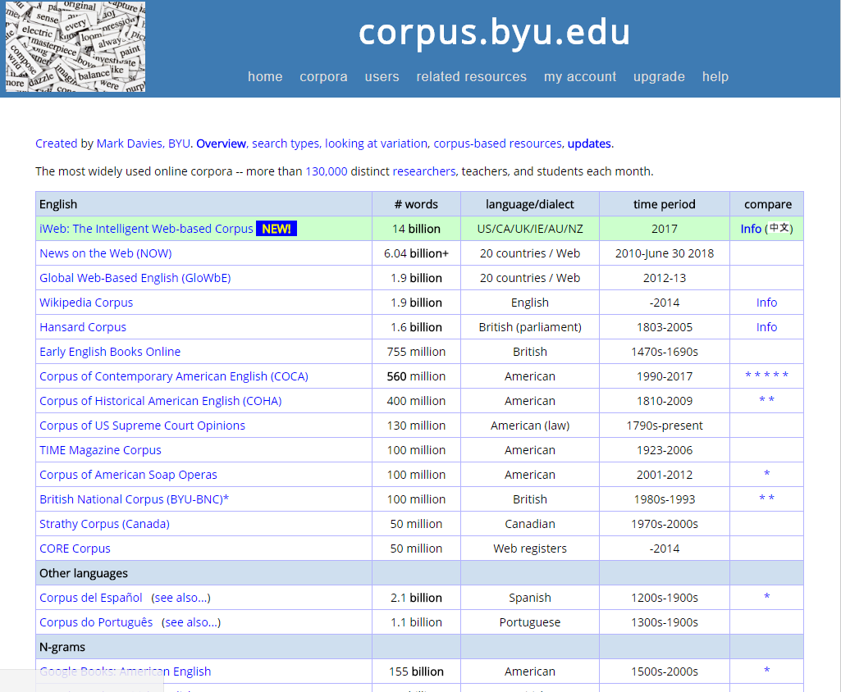
Gathering the corpus
Online free corpora:
Nltk-data: https://raw.githubusercontent.com/nltk/nltk_data/gh-pages/index.xml
Brigham Young University: https://corpus.byu.edu/
British National Corpus: http://www.natcorp.ox.ac.uk/
Martin Weisser: http://martinweisser.org/
Web scrapping:
Social media
Information resources

Slide 8
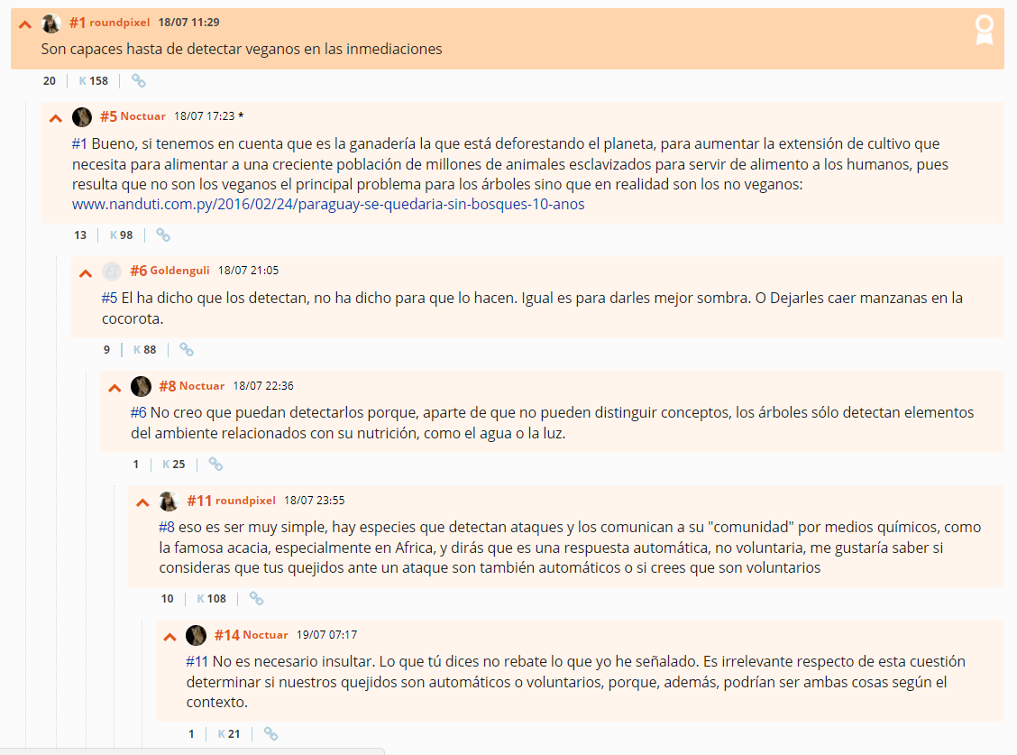
What texts do we find in social media?
Tweets
Hashtags
Tags
Posts
Comments

Slide 9
Steps for text analysis:
Gathering the corpus
1
Pre-processing
2
Text modelling
3
Results
4

Slide 10
Pre-processing: (or trying to facilitate text representation)
Tokenization
Stop and rare word removal
Lemmatization and stemming

Slide 11
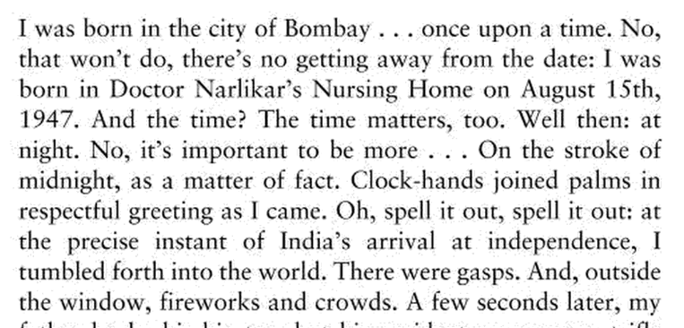
Tokenization
city of Bombay
won’t/there’s
August 15th
…
ex-Malaysian prime minister
Hewlett-Packard
state-of-the-art
nineteen eighty
San Francisco

Slide 12
Tokenization
Chinese and Japanese do not use spaces between words:
莎拉波娃现在居住在美国东南部的佛罗里达。
莎拉波娃 现在 居住 在 美国 东南部 的 佛罗里达
Sharapova ahora vive en EEUU sudeste de Florida
Japanese also uses different alphabets:
フォーチュン500社は情報不足のため時間あた$500K(約6,000万円)
Katakana
Hiragana
Kanji
Romaji

Slide 13
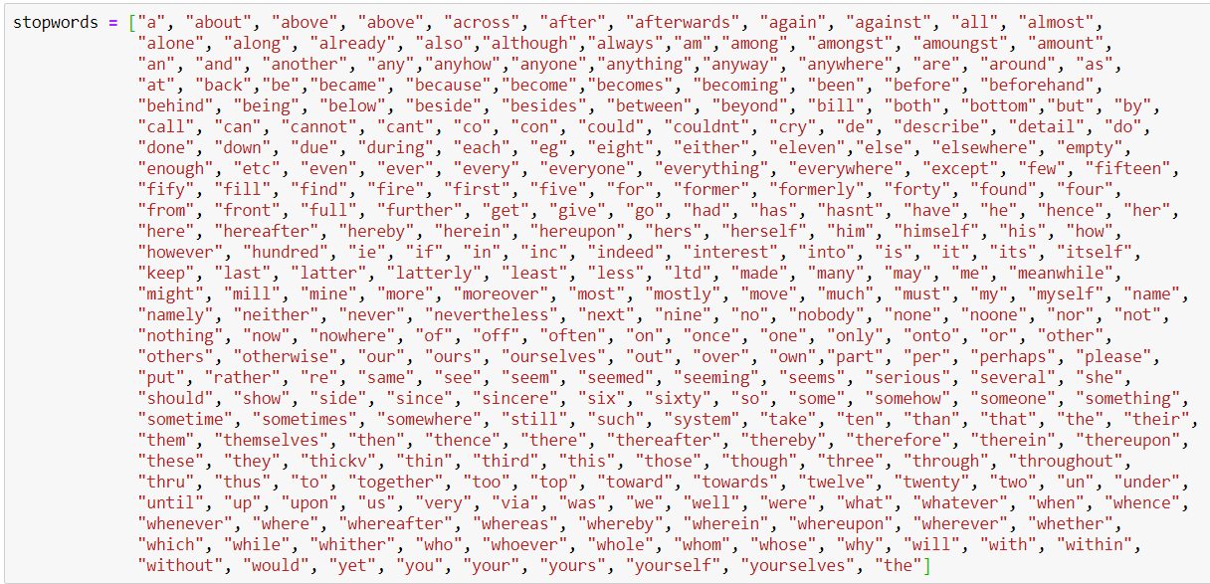
Stop word removal

Slide 14
Lemmatization and stemming
Remove inflectional endings and go back to the base:
Chop off word endings:
smiling
smiled
smiles
smiling
smiled
smiles
smile
smil

Slide 15
Problems with texts we find in social media
Time sensitivity (dynamic language):
blogs, microblogs, social networks
Short length (limitation of characters):
missing contextual information → semantic gap
Unstructured data:
variance in the content quality
acronyms and abbreviations (and misspellings)
Abundant information: tons of data!!
Non-standard language
and misspellings
User comments in Twitter
Great job @justinbieber! Were SOO PROUD of what youve accomplished! U taught us 2 #neversaynever & you yourself should never give up either♥

Slide 16
Applications in real-world:
Event detection, and prediction of the popularity of news
Take advantage of collaborative QA
Fill in semantic gap (improve BOW clustering)
Sentiment analysis
Identify influencers, and review quality prediction (how faithful is an opinion?)

Slide 17
Steps for text analysis:
Gathering the corpus
1
Pre-processing
2
Text modelling
3
Results
4

Slide 18
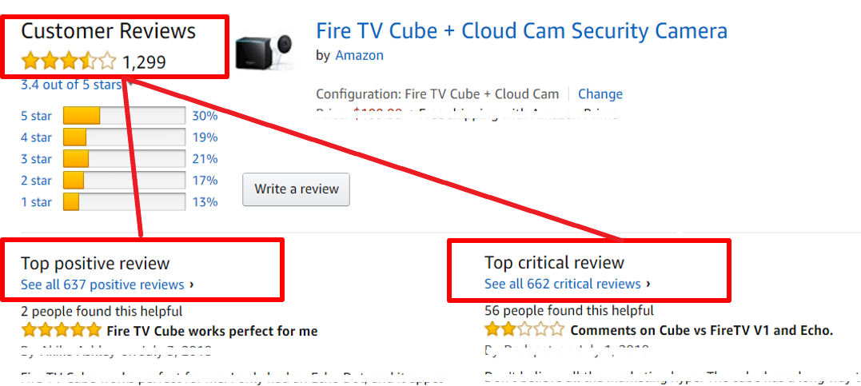
Defining the task: what do we want to extract from this site?
Sentiment analysis

Slide 19
Strategies for Sentiment Recognition
Supervised learning
labelled corpus
predefined categories
sentiment lexicons
Unsupervised learning
unlabelled corpus
category discovery
k-means

Slide 20
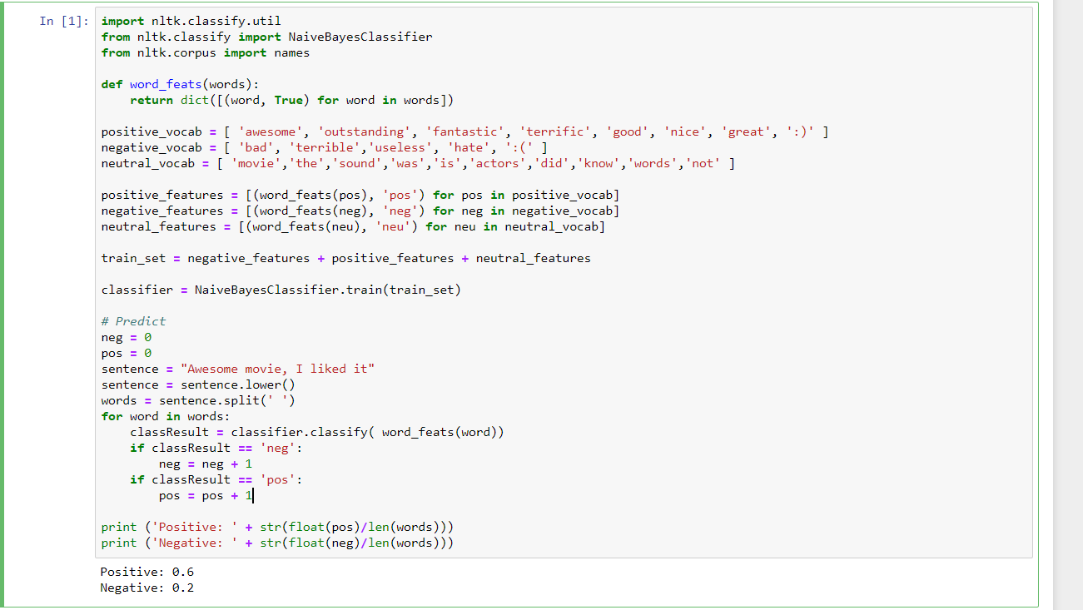
Basic algorithm for sentiment analysis:
https://www.cs.cornell.edu/people/pabo/movie-review-data/
INPUT: List of positive, negative and neutral words
The comments we want to analyse
RESULT: postive and negative score

Slide 21
Sentiment lexicons
Simplest lexicons are represented in a binary fashion
Wordlist of positive words
Wordlist of negative words
General Inquirer (Stone et al., 1966): http://www.wjh.harvard.edu/~inquirer/
The MPQA Subjectivity lexicon (Wilson et al., 2005), from a variety of sources: http://mpqa.cs.pitt.edu/lexicons/subj_lexicon/

Slide 22
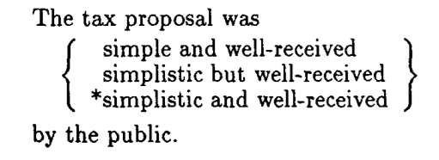
“Polarity” lexicons: Hatzivassiloglou & McKeown 1997

Slide 23
“Polarity” lexicons: Hatzivassiloglou & McKeown 1997
brutal
helpful
irrational
nice
corrupt
Negative
fair
classy
Example from Dan Jurafski
(Stanford NLP course)
Positive

Slide 24
Summary
Gathering the corpus
1
Preprocessing
2
Text modelling
3
Results
4

Slide 25
Using Lexicons for Sentiment Recognition:
pros and cons
Pros:
Topic discovery is a challenge due to semantic gap and lexicons are really helpful
Performance is better
Cons:
Problems when having to deal with dynamic language
Labelling a corpus requires many resources and is time consuming

Slide 26
Bibliography:
Unsupervised Streaming Feature Selection in Social Media, Jundong Li, Xia Hu, Jiliang Tang and Huan Liu. (2015) http://www.public.asu.edu/~jundongl/paper/CIKM15_USFS.pdf
Mining text data. Ed. Charu C. Aggarwal, ChengXiang Zhai. Springer (2012)
Speech and Language Processing (3rd ed. draft). Jurafsky, Dan; Martin, James H. (2017) https://web.stanford.edu/~jurafsky/slp3/

Slide 27
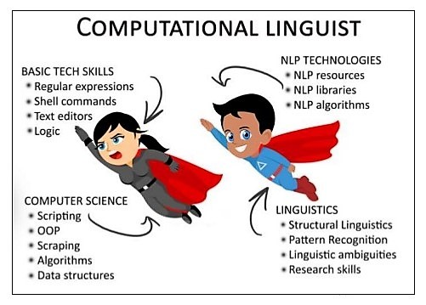
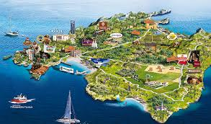
About me
Definition
NLP: a peek into a day of a computational linguist
Mariana Romanyshyn, Technical Lead, Computational Linguist at Grammarly, Inc.

Slide 28
THANKS FOR WATCHING!
Twitter: @linguistsmatter
LinkedIn: https://www.linkedin.com/in/eulaliaveny/

Slide 29
Sentiment lexicons
Semi-supervised lexicons (three methods):
seed words and adjective coordination
pointwise mutual information
using WordNet synonyms and antonyms

Slide 30
Sentiment lexicons
Supervised learning of word sentiment
Log odds ratio informative Dirichlet prior
(add more methods)

Slide 31
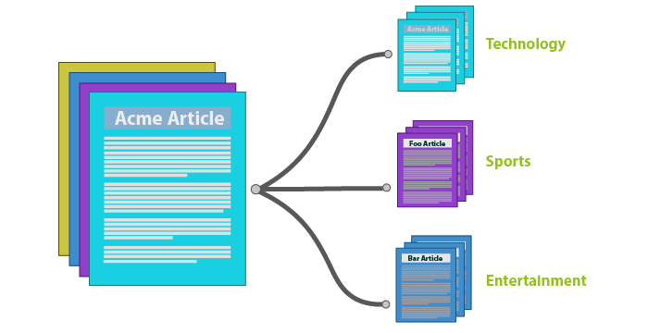
Text classification:

Slide 32
Procesamiento del lenguaje natural: dificultades
Non-standard language
and misspellings
Frases hechas e
información contextual
Tokenization
ex prime minister
Hewlett-Packard
state-of-the-art
nineteen eighty
San Francisco
User comments in Twitter
Great job @justinbieber! Were SOO PROUD of what youve accomplished! U taught us 2 #neversaynever & you yourself should never give up either♥
Meter la pata
Tirar la toalla
Jugar con fuego
Quiero comprarle un regalo a mi madre.

Slide 33
Corrección ortográfica y Minimum edit distance:
C E T S A
Similitud entre dos ‘strings’:
Un usuario escribe “cetsa”
¿Qué palabra está más cerca?
cesta,
cesa,
cuesta,
cresta…
MED = número mínimo de ediciones:
inserción
supresión
sustitución
C E S T A
C * E T S A
C U E S T A

Slide 34
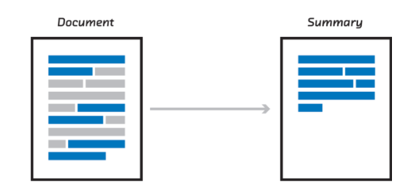
Text summarization:

