Slide 1
Building a Naive Bayes Text Classifier with scikit-learn
Obiamaka Agbaneje
@ EuroPython 2018, Edinburgh

Slide 2
About me
+
2009-2017
2009

Slide 3
Introduction
Naïve Bayes
About the dataset
Concepts
Code
Learnings

Slide 4
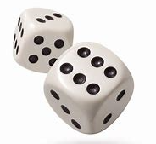
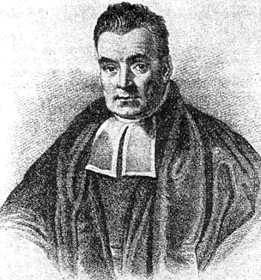
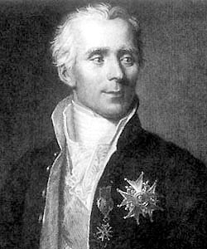
Naïve Bayes: A Little History
Reverend Bayes
Pierre-Simon Laplace
Bayes Theorem
P(A|B) = P(B|A) P(A)
P(B)

Slide 5
Naïve Bayes: Advantages and Disavantages
Advantages
Very simple to implement and fast
Works well even when the feature independence assumption does not hold as in the case of text
Deals well with data sets that have very large feature spaces
Disadvantages
Does not work well with expressions that have a combination of words with unique meanings.

Slide 6
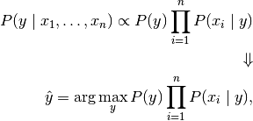
Naïve Bayes: The Equation

Slide 7
Naïve Bayes: The Equation
Notes:
This formula looks a bit complicated even to me! Hopefully by the end of this presentation it would be clearer.

Slide 8
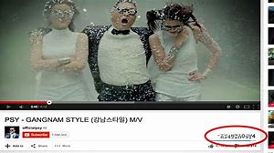
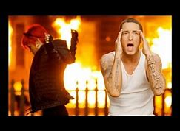
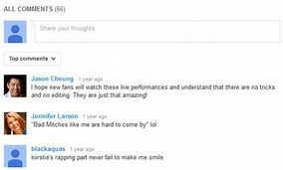
About the dataset: YouTube Spam Collection
Among the 10 most viewed videos on Youtube at the time
Reference: Alberto et al. http://www.dt.fee.unicamp.br/~tiago//youtubespamcollection/

Slide 9
Pre-requisites

Slide 10
Naïve Bayes: An example
Spam
I love song
Ham

Slide 11
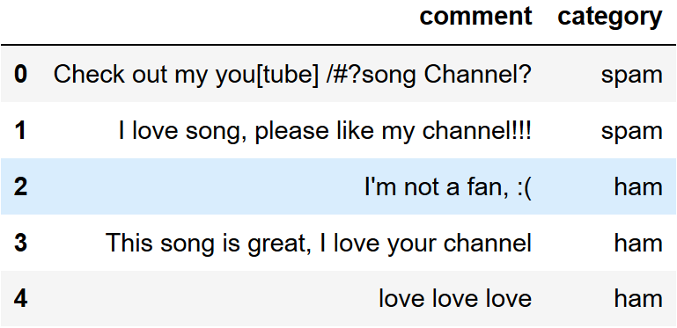
Naïve Bayes: An example
I love song
?

Slide 12
Naïve Bayes: An example
Check out my you[tube] /#?song Channel?
tokenize
Check | out | my | you | tube | song | Channel
lower case
check | out | my | you | tube | song | channel
remove stop words
check | tube | song | channel
count words
check | tube | song | channel
1 | 1 | 1 | 1

Slide 13
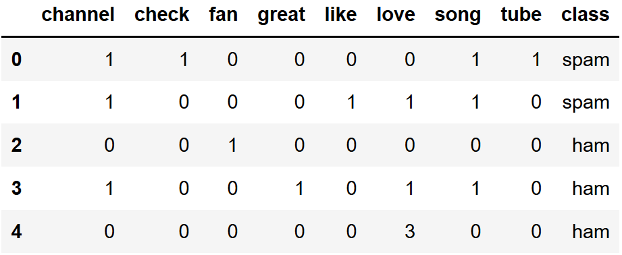
Naïve Bayes: The Equation
I love song
?

Slide 14
Naïve Bayes: The Equation
P(Spam|I love song) = P (Spam) x P(I love song|Spam)
P(I love song)
P(Ham|I love song) = P (Ham) x P(I love song|Ham)
P(I love song)

Slide 15
Naïve Bayes: The Equation
Calculating the apriori:
P(Spam) = # of Spam comments
2
=
5
# total comments
P(Ham) = # of Ham comments
3
=
5
# total comments
Notes:
First, we calculate the apriori probability that the document is spam and the document is ham, which can easily be obtained by counting the number of documents in each class dividing it by the total number of documents.

Slide 16
Naïve Bayes: The Equation
Calculating conditional probability:
1
2
P(love|Spam) x P(song|Spam)
=
x
8
8
1
=
32
4
1
P(love|Ham) x P(song|Ham)
=
x
8
8
1
=
16

Slide 17
Naïve Bayes: The Equation
Calculating conditional probability:
1
1
P(Spam|love song)
=
x
5
32
0.006
=
4
1
I love song
ham
P(Ham|love song)
=
5
x
16
0.05
=
Notes:
We get the products of the apriori and the conditional probabilities and compare the results for spam and ham and we can see that the probability of this instance being spam is greater than the probability of it being ham.

Slide 18
Naïve Bayes: and now for the Code

Slide 19
Loading the Dataset

Slide 20
Loading the Dataset

Slide 21
Sub-setting

Slide 22
Train/test split

Slide 23
Feature extraction: Bag of words approach

Slide 24
Bag of words approach-Training

Slide 25
Bag of Words approach-Testing and Evaluation

Slide 26
Feature Extraction: TF-IDF Approach

Slide 27
TF-IDF Approach: Training

Slide 28
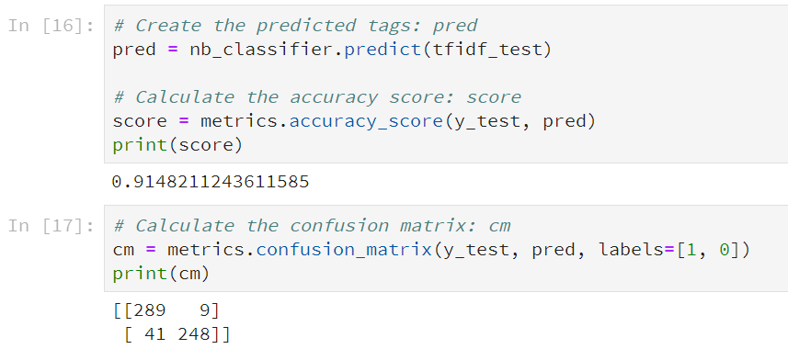
TF-IDF Approach: Testing and Evaluation

Slide 29
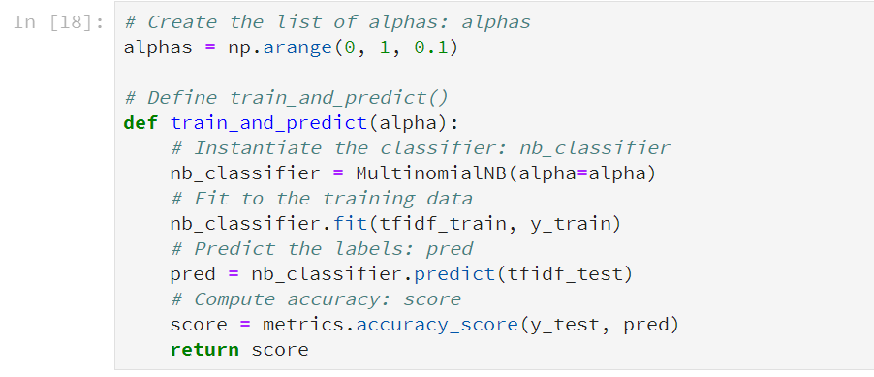
Tuning parameters : Laplace smoothing

Slide 30
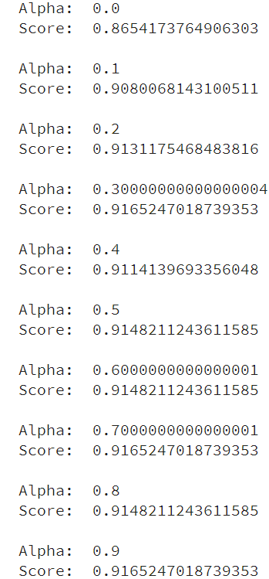
Tuning parameters : Laplace smoothing

Slide 31
Learnings
Naïve Bayes
About the dataset
Concepts
Code
Learnings

Slide 32
Thank you!
Obiamaka Agbaneje
Twitter: @obiamaks
Github: oagbaneje
Email: obiamaka.agbaneje@gmail.com
Linkedin:https://www.linkedin.com/in/obiamaka-agbaneje-038a501b/

Slide 33
Credits
Susan Krueger: adviced me the slides and content
Aisha Bello: making me apply for the CFP

Slide 34
References
Jarmul, K https://www.datacamp.com/courses/natural-language-processing-fundamentals-in-python
https://archive.ics.uci.edu/ml/datasets/YouTube+Spam+Collection
Alberto, T.C., Lochter J.V., Almeida, T.A. TubeSpam: Comment Spam Filtering on YouTube. Proceedings of the 14th IEEE International Conference on Machine Learning and Applications (ICMLA'15), 1-6, Miami, FL, USA, December, 2015.
Stecanella B, A practical explanation of a Naive Bayes classifier, https://monkeylearn.com/blog/practical-explanation-naive-bayes-classifier/

